Slide 1
Simulation Modeling Analysis
Introduction
Md. Fazlul Karim Patwary
Professor
Institute of Information Technology Jahangirnagar University

Slide 2
What is Simulation? (From wiki)
Simulation is the imitation of the operation of a real-world process or system over time.
The act of simulating something first requires that a model be developed; this model represents the key characteristics or behaviors/functions of the selected physical or abstract system or process.
The model represents the system itself, whereas the simulation represents the operation of the system over time.

Slide 3
Why do we need Simulation?
To understand existing (natural or human) systems
To build new systems
Show the eventual real effects of alternative conditions and courses of action.
The real system cannot be engaged, because it may not be accessible, or it may be dangerous or unacceptable to engage, or it is being designed but not yet built, or it may simply not exist.

Slide 4
Key Steps in Simulation
Collecting valid and relevant source information about the system (including key characteristics and behaviors)
Setting, approximations, and assumptions within the simulation
Justifying the fidelity and validity of the simulation outcomes (data)
Statistics is the study of the collection, organization, analysis, interpretation and presentation of data.

Slide 5
Why does this course related to your career?
If you will work in the IT industry:
System and network design is very important in middle to large scale IT projects
Which require fundamental knowledge in queueing theory and statistics; simulation is the basic skill too.
If you will work in financing or big-data related industry:
Modeling and simulations are two fundamental skills to establish and test your ideas on algorithms/systems
If you will pursue further studies:
Modeling and simulation are essential for researchers in information engineering (networking, communication, image processing)

Slide 6
Course Objectives
Introduce simulation as a network and system design strategy
Train students with the knowledge of
Simulation and modeling
Statistical analysis
Network and system design
After the course, you will gain:
Theoretical knowledge in queueing and statistics
Practical experiences in simulation

Slide 7
Text Book
Simulation Modeling and Analysis
Averill M. Law & W. David Kelton

Slide 8
Lecture-01
Introduction to Simulation

Slide 9
Outline of this lecture
Systems, Models, and Simulation
Discrete-Event Simulation
Steps in Sound Simulation study
Advantages, Disadvantages, and Pitfalls of Simulation

Slide 10
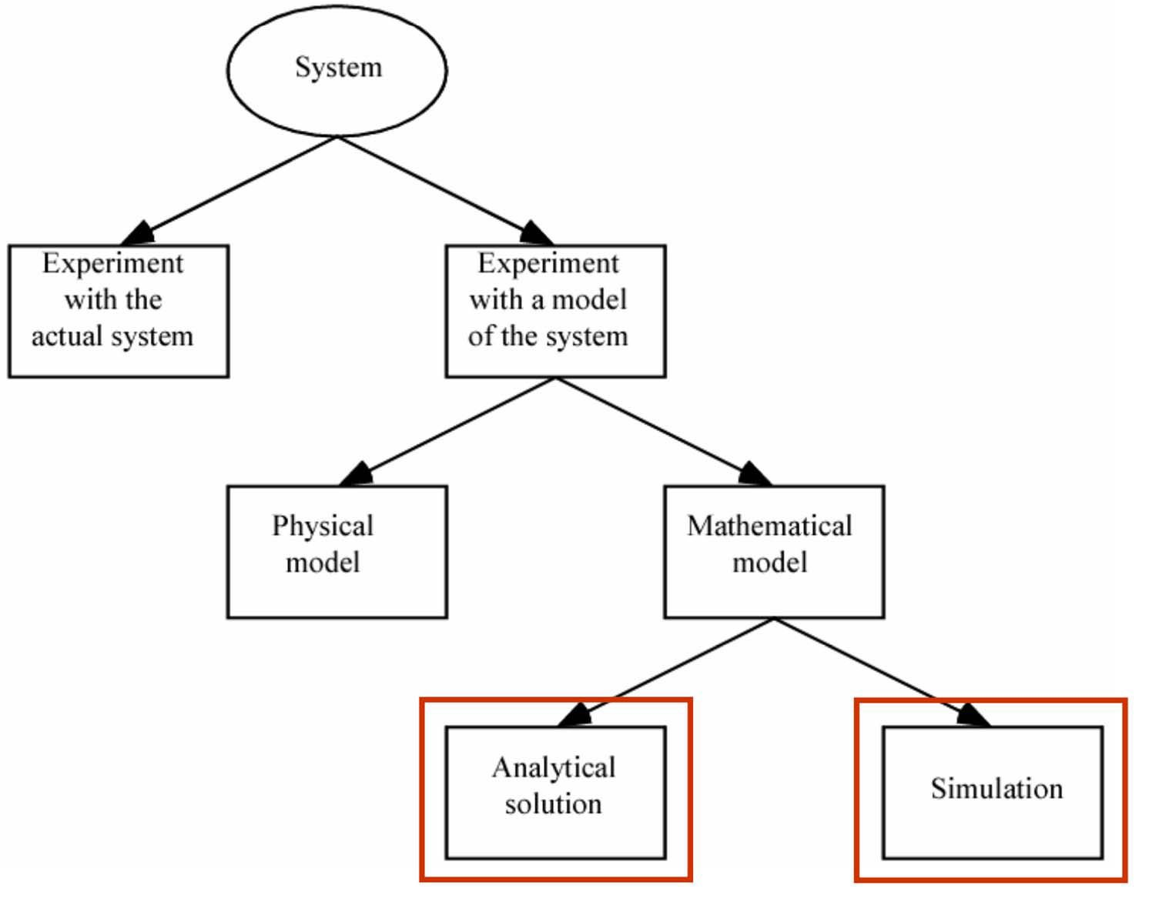
SYSTEMS, MODELS, AND SIMULATION
Ways to study a system

Slide 11
Analytical Solution: Pros and Cons
Analytical solution: Use mathematical methods to get information on questions of interest
E.g., estimating total $$$ spent per month on buying magazines
E.g., characterizing average waiting time in a bank by Queuing Theory
Advantages:
Clean answers in a cost-effective way
Can (relatively) easily explore how to optimize the performance
Disadvantages:
Only work with tractable models (not applicable to most real systems)
Only explore the specific performance metric (you may as well be interested in many other metrics, simultaneously)

Slide 12
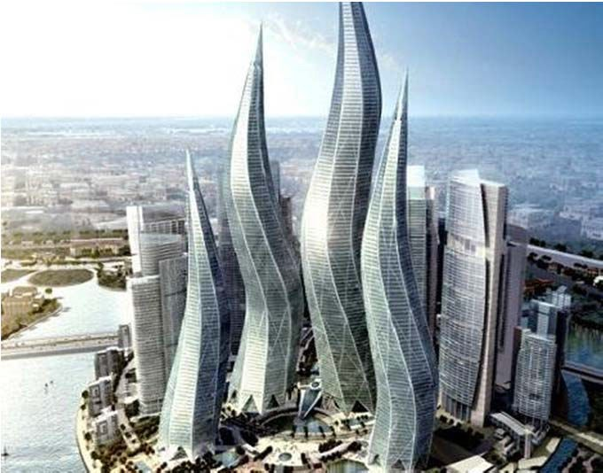
Nature of Simulation
Most real systems are described by complex models
Must be studied via simulation
Estimate model characteristics
Run simulation and collect data; and
Analysis and evaluate the model numerically
Example:
Can we build it and see if it works out?

Slide 13
Nature of Simulation
Some application areas:
Designing and analyzing manufacturing systems
Evaluating military weapons systems or their logistics requirements
Determining hardware and software requirements for a computer system
Designing and operating transportation systems such as airports, freeways, ports, and subways
Evaluating designs for service organizations such as call centers, fast-food restaurants, hospitals, and post offices
Reengineering of business processes
Determining ordering policies for an inventory system
Analyzing financial or economic systems
Computer simulation games

Slide 14
SYSTEMS, MODELS, AND SIMULATION
System: A collection of entities (people, parts, messages, machines, servers, …) that act and interact together toward some end.
In simulations, depends on objectives of study
Might limit the boundaries (physical and logical) of the system
Specify the level of detail (e.g., what is an entity?)
Usually assume a time element - dynamic system

Slide 15
SYSTEMS, MODELS, AND SIMULATION
State of a system: Collection of variables and their values necessary to describe the system
Might depend on desired objectives, output performance measures
Website model: Number of client requests, number of server processes, network bandwidth etc.
Game model: Weapons own by each characters, energy level etc.

Slide 16
SYSTEMS, MODELS, AND SIMULATION
Types of systems
Discrete
State variables change instantaneously at separated points in time
Bank model: State changes occur only when a customer arrives or departs
Continuous
State variables change continuously as a function of time
Airplane flight: State variables like position, velocity change continuously
Many systems are partly discrete, partly continuous

Slide 17
SYSTEMS, MODELS, AND SIMULATION
Classification of simulation models
Static vs. dynamic
Deterministic vs. stochastic (contain randomness)
Continuous vs. discrete
Most operational models are dynamic, stochastic, and discrete - will be called discrete-event simulation models
This course focuses on discrete-event simulations

Slide 18
Discrete-Event Simulation
Discrete-event simulation: Modeling of a system as it evolves over time by a representation where the state variables change instantaneously at separated points in time
More precisely, state can change at only a countable number of points in time
These points in time are when EVENTS occur
Event : Instantaneous occurrence that may change the state of the system
Discrete-event simulation can in principle be done by hand, but usually done on computer.
Entities :
They are objects that compose a simulation model
E.g. customers and servers
Characterized by data values called attributes
For each entity resident in the model there’s a record

Slide 19
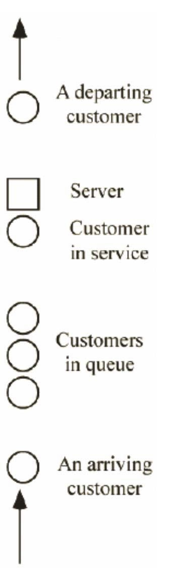
Discrete-Event Simulation: Example
Example: Single-server queue
Objective: to estimate expected average delay in queue (line, not service)
State variables
Status of server (idle, busy) - needed to decide what to do with an arrival
Current length of the queue - to know where to store an arrival that must wait in line
Time of arrival of each customer now in queue - needed to compute time in queue when service starts
Servicing time for each particular customer
Events
Arrival of a new customer
Service completion (and departure) of a customer
Maybe - end-simulation event (a “fake” event) - whether this is an event depends on how simulation terminates (a modeling decision)

Slide 20
Time-Advance Mechanisms
Simulation clock: Variable that keeps the current value of (simulated) time in the model
Must decide on, be consistent about, time units
Usually no relation between simulated time and (real) time needed to run a model on a computer
Two approaches for time advance
Next-event time advance (usually used)
Fixed-increment time advance
Simulation clock is advanced in increments of exactly ∆t time units. After each update of the clock, a check is made to determine if any events should have occurred during the previous interval of length ∆t

Slide 21
Time-Advance Mechanisms
The Next-event Time Advance Approach
Determine the times of occurrence of “future” events (keep an initial event list)
Initialize simulation clock to 0
Clock advances to the most imminent of these future events
At which point the state of the system is updated to account for the fact that an event has occurred and/or executed
Event execution may involve updating event list
Then the simulation clock is advanced to the time of the new most imminent event, the state of the system is updated, and future event times are determined
next (most imminent) event, which is executed
Event execution may involve updating event list
Continue until stopping rule is satisfied (must be explicitly stated)
Clock “jumps” from one event time to the next, and doesn’t “exist” for times between successive events
Periods of inactivity are ignored

Slide 22
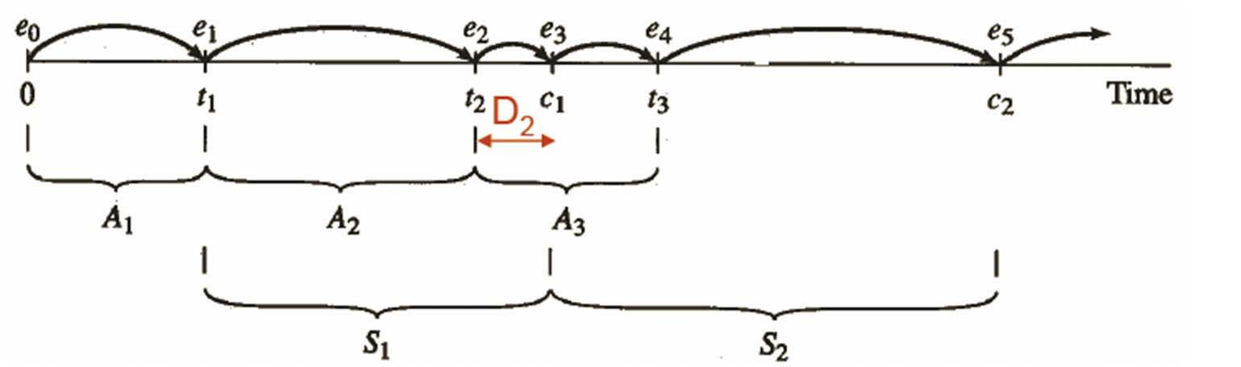
Time-Advance Mechanisms
Next-event time advance for the single-server queue
t_{i} = time of arrival of ith customer (t₀ = 0)
A_{i} = t_{i} - t_{i-1} = interarrival time between (i-1)st and ith customers (usually assumed to be a random variable from some probability distribution)
S_{i} = service-time requirement of ith customer (another random variable)
D_{i} = delay in queue of ith customer
C_{i} = t_{i} + D_{i} + S_{i} = time ith customer completes service and departs
e_{j} = time of occurrence of the jth event (of any type), j = 1, 2, 3, …

Slide 23
Components of a Discrete Event Simulation
System state - the collection of variables to describe the system at a particular time
Simulation clock - a variable giving the current value of simulated time
Event list - a list containing the next time when each type of event will occur
Statistical counters - variables used for storing statistical information about system performance

Slide 24
Organization of a Discrete Event Simulation
Initialization routine - a module to initialize the simulation model at time 0
Timing routine - a module that determines the next event from the event list and then advances the simulation clock to the time when that event is to occur
Event routines - to carry out logic for each event type. For each of the event type, there is a module to updates the system state when that particular type of event occurs
Library routines - utility routines / library (e.g. CSIM) to generate random variables according to the probability distributions
Report generator - to summarize, report results at end
Main program - ties routines together, executes them in right order. Also checks for termination

Slide 25
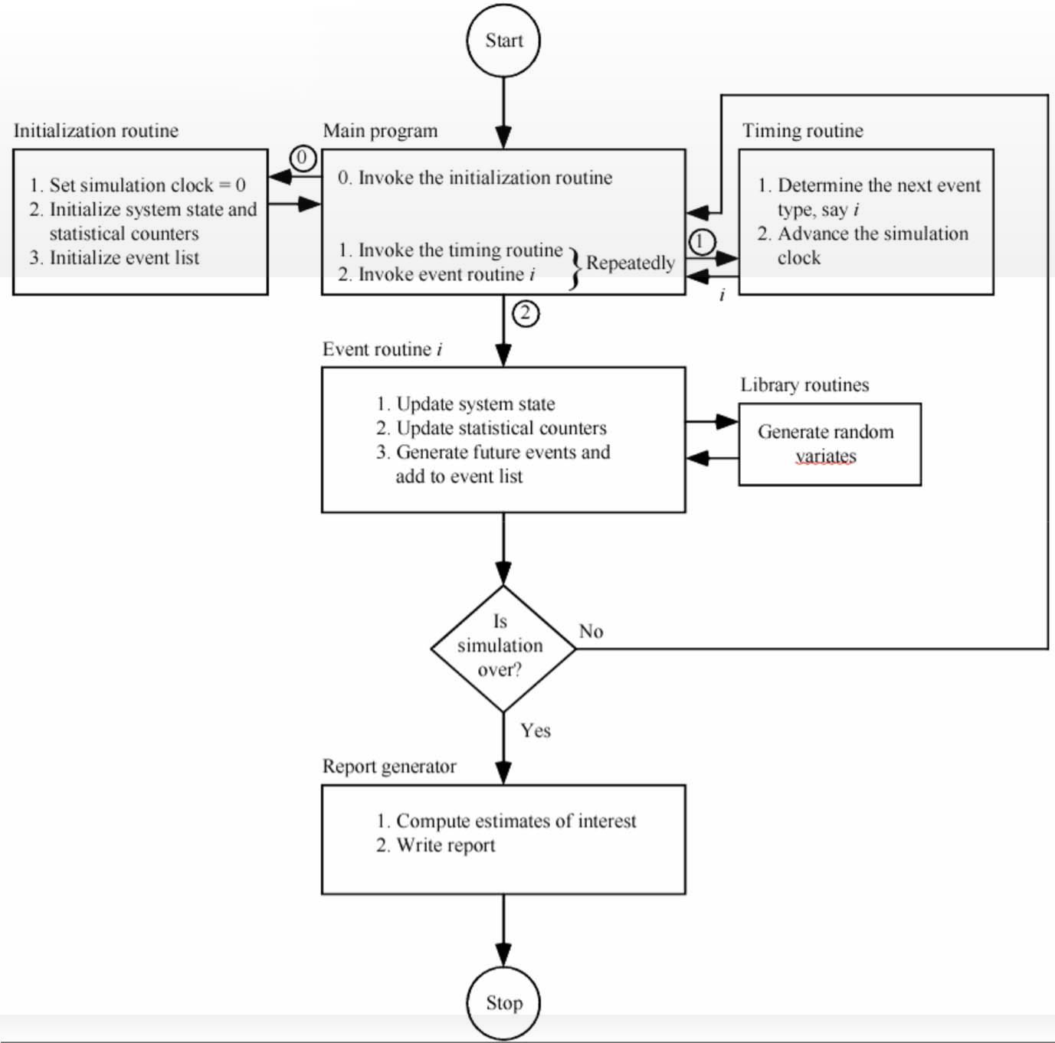
Flow Chart of a Discrete Event Simulation

Slide 26
Steps in a Sound Simulation Study
Step One: Formulate the problem and plan the study
Step Two: Collect information and data to define a model
Choose the level of model detail
Document it
Step Three: Check if the assumptions document valid
If no, go back to step two
Step Four: Construct a computer program and verify
Programming languages
Simulation software
Step Five: Make pilot runs

Slide 27
Steps in a Sound Simulation Study
Step Six: Validate the programmed model
If there is an existing system, compare model and system performance measures for the existing system
Use sensitivity analyses to determine what model factors have a significant impact on performance measures, and modify the model when necessary
Step Seven: Design experiments
Specify length of each simulation run and warm-up period
Step Eight: Make production runs and get the output data
Step Nine: Analysis output data
Step Ten: Document, present, and use results
Discuss model building and validation process to promote credibility

Slide 28
Simulation: Discussions
Advantages
Simulation allows great flexibility in modeling complex systems, so simulation models can be highly valid
Easy to compare alternatives
Control experimental conditions
Disadvantages
Stochastic simulations produce only estimates - with noise
Simulation models can be expensive to develop
Simulations usually produce large volumes of output - need to summarize, statistically analyze appropriately
Pitfalls
Failure to identify objectives clearly up front
Inappropriate level of detail (both ways)
Inadequate design and analysis of simulation experiments

Slide 29
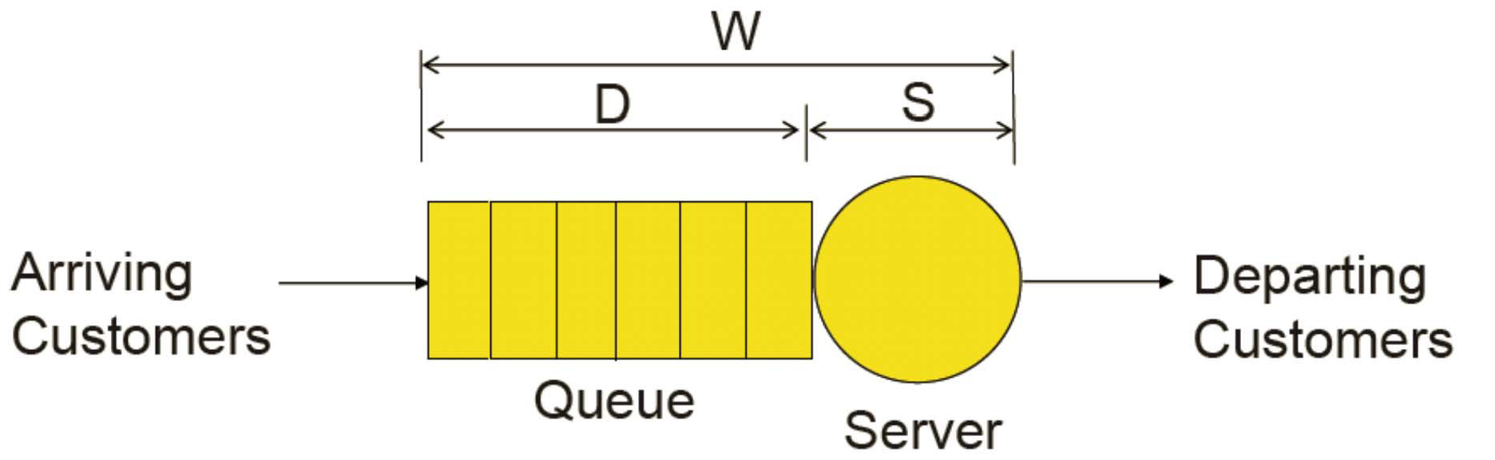
Single-Queue Single-Server System
Single-server queueing system
A Queueing System consists of one or more servers that provide service to arriving customers
A customer who arrive to find all servers busy join one in front of the server
Single-Queue Single-Server system: a queueing system with only one server which has only one queue
For a customer: W = total waiting time in the system, D = delay in queue, S = service time

Slide 30
Single-Queue Single-Server System
Interarrival times A₁, A₂, … are assumed to be independent and identically distributed (IID) random variables
Independent:
Identically Distributed: have the same probability distribution
Examples of probability distribution:
Uniform: for complete random variables
Normal: the sum of a large number of other quantities
Exponential: e.g. interarrival times of customers to a system according to a homogeneous Poisson process

Slide 31
Problem Statement
A single-queue single-server system
When a customer arrives
If the server is idle: enters service immediately
If the server is busy: wait at the end of the queue
Service discipline: FIFO (first-in-first-out)
Random variables:
Interarrival times A₁, A₂, … are IID
Service times S1, S2, … are IID
The two sets variables are independent of each other

Slide 32
Problem Statement
Initial state: “empty-and-idle”
time t = 0
no customers
idle server
Wait for the arrival of the first customer
occurs at the first interarrival time A₁
Stopping-rule: the n-th customer enters the service
A fixed number of customers have completed their delays in queue the system
Note: the time the simulation ends is also a random variable!

Slide 33
Performance Metrics
d(n): Expected average delay in queue of n-th customer
excluding service time
“Expected”: the average delay is a random variable
“the average of averages”
q(n): Expected average number of customers in queue
(excluding any in service)
❐
u(n): Expected utilization of the server
proportion of time busy
How busy the server is

Slide 34
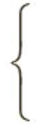
Key Issues in Simulation
Q(t): the queue length at time t
B(t): the busy function against t
ۓ1 if the server is busy at time t
ە0 if the server is idle at time t
B(t) =
T(n): the time required to observe n delays in queue
time elapsed when the n-th customers completes its delay in queue and start being served
In our example, simulation will ends at T(6)

Slide 35
Paper-and-Pencil Simulation
Suppose virtual customers are generated with the following interarrival time and service time
■ A₁ = 0.4, S₁ = 2.0
■ A₂ = 1.2, S₂ = 0.7
■ A₃ = 0.5, S₃ = 0.2
■ A₄ = 1.7, S₄ = 1.1
■ A₅ = 0.2, S₅ = 3.7
■ A₆ = 1.6, S₆ = 0.6
■ A₇ = 0.2, A₈ = 1.4, A₉ = 1.9
In computer simulations, the A_{i}’s and S_{i}’s would be generated from their corresponding probability distributions

Slide 36
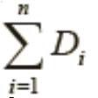
Paper-and-Pencil Simulation
Observe and record the following values:
Clock
Event list
A: time for next arrival
D: time for next departure
System state
Server status
Number in the queue
Arrival of each customer in queue, time of last event
Statistical counters
Number delayed (=number of customer has ever been delayed, including being in service. Simulation ends when its value = 6)
Total delay (=
Area under Q(t)
Area under B(t)
where n = number delayed)

Slide 37
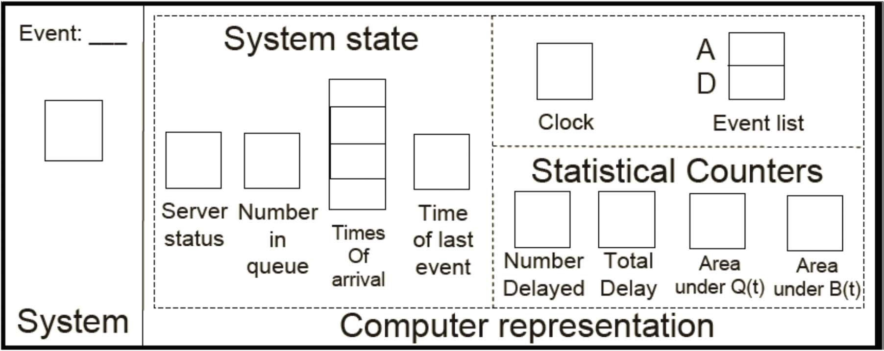
Paper-and-Pencil Simulation
Interarrival times: 0.4, 1.2, 0.5, 1.7, 0.2, 1.6, 0.2, 1.4, 1.9, …
Service times: 2.0, 0.7, 0.2, 1.1, 3.7, 0.6, …

Slide 38
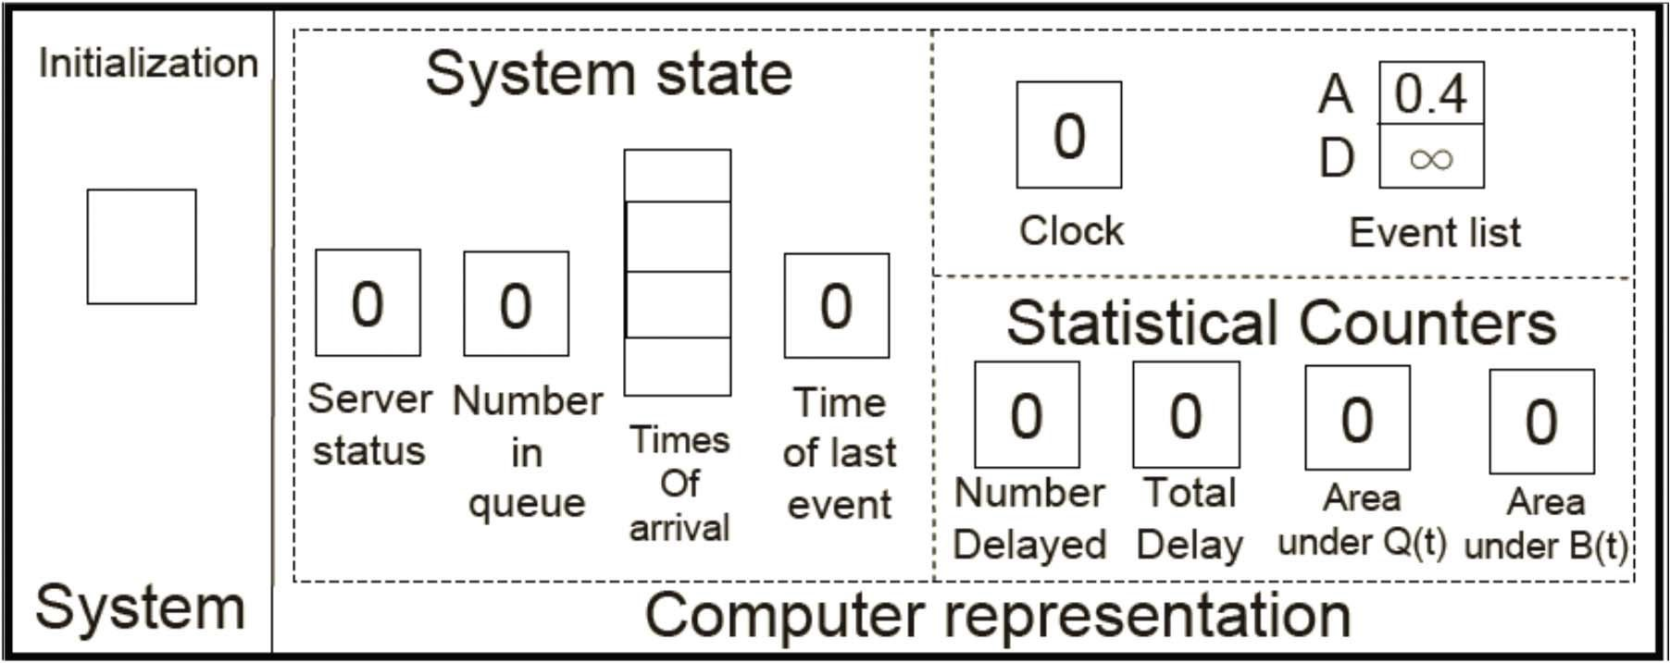
Paper-and-Pencil Simulation
Initialization
Interarrival times: 0.4, 1.2, 0.5, 1.7, 0.2, 1.6, 0.2, 1.4, 1.9, …
Service times: 2.0, 0.7, 0.2, 1.1, 3.7, 0.6, …

Slide 39
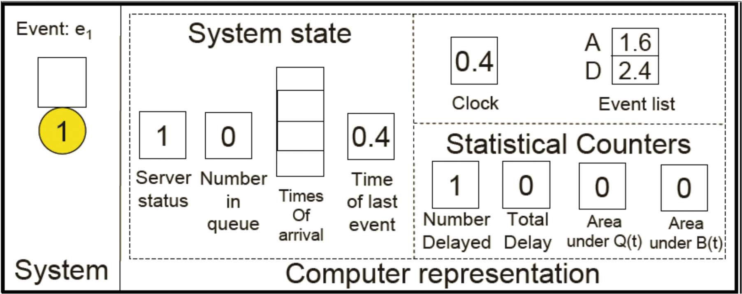
Paper-and-Pencil Simulation
Event 1: arrival of Customer 1
Interarrival times: 0.4, 1.2, 0.5, 1.7, 0.2, 1.6, 0.2, 1.4, 1.9, …
Service times: 2.0, 0.7, 0.2, 1.1, 3.7, 0.6, …
D₁ = period of time that customer 1 has been in the queue = 0 Total delay = D₁ = 0

Slide 40
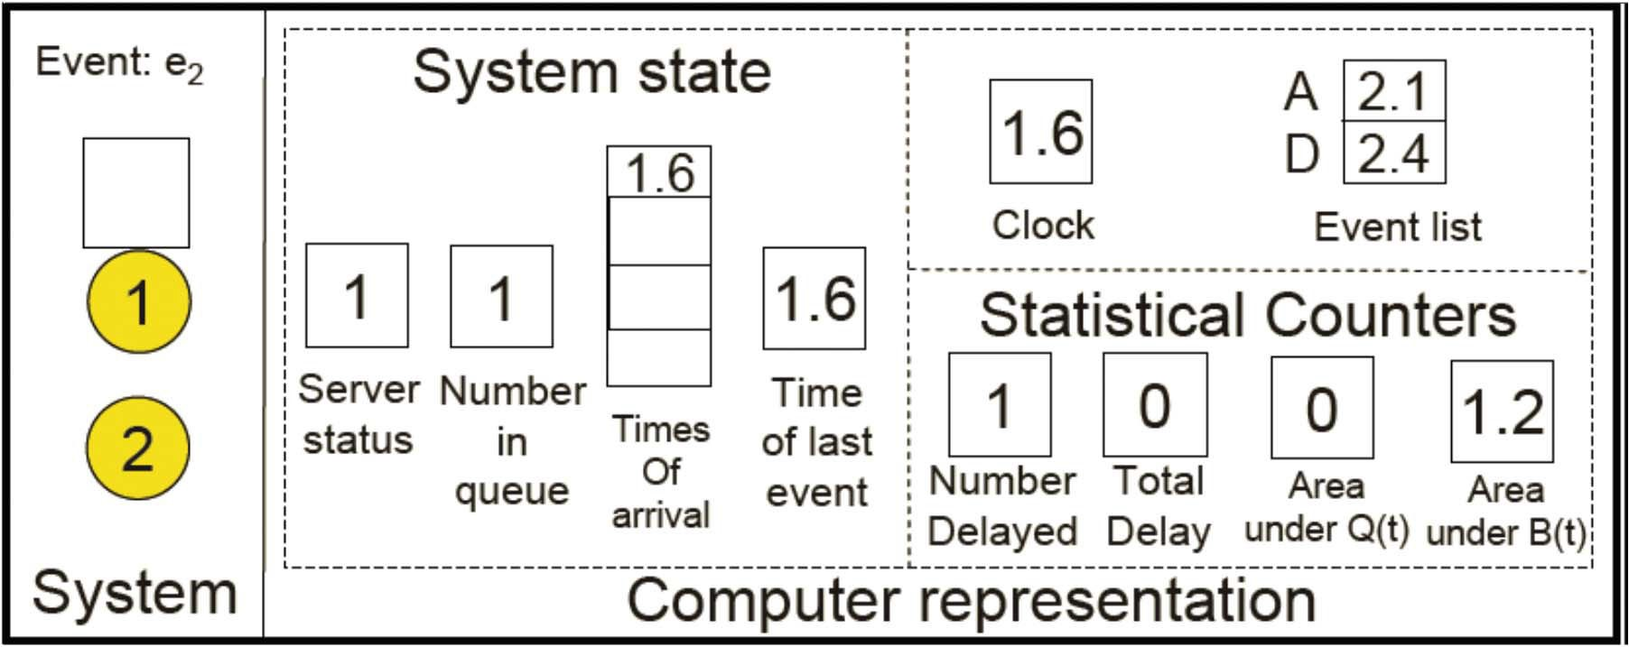
Paper-and-Pencil Simulation
Event 2: arrival of Customer 2
Interarrival times: 0.4, 1.2, 0.5, 1.7, 0.2, 1.6, 0.2, 1.4, 1.9, …
Service times: 2.0, 0.7, 0.2, 1.1, 3.7, 0.6, …

Slide 41
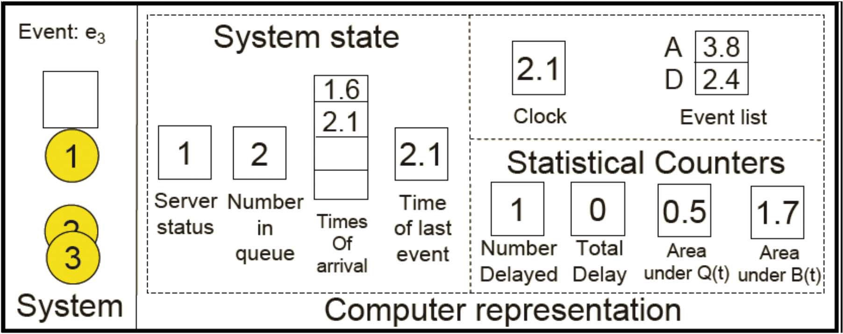
Paper-and-Pencil Simulation
Event 3: arrival of Customer 3
Interarrival times: 0.4, 1.2, 0.5, 1.7, 0.2, 1.6, 0.2, 1.4, 1.9, …
Service times: 2.0, 0.7, 0.2, 1.1, 3.7, 0.6, …

Slide 42
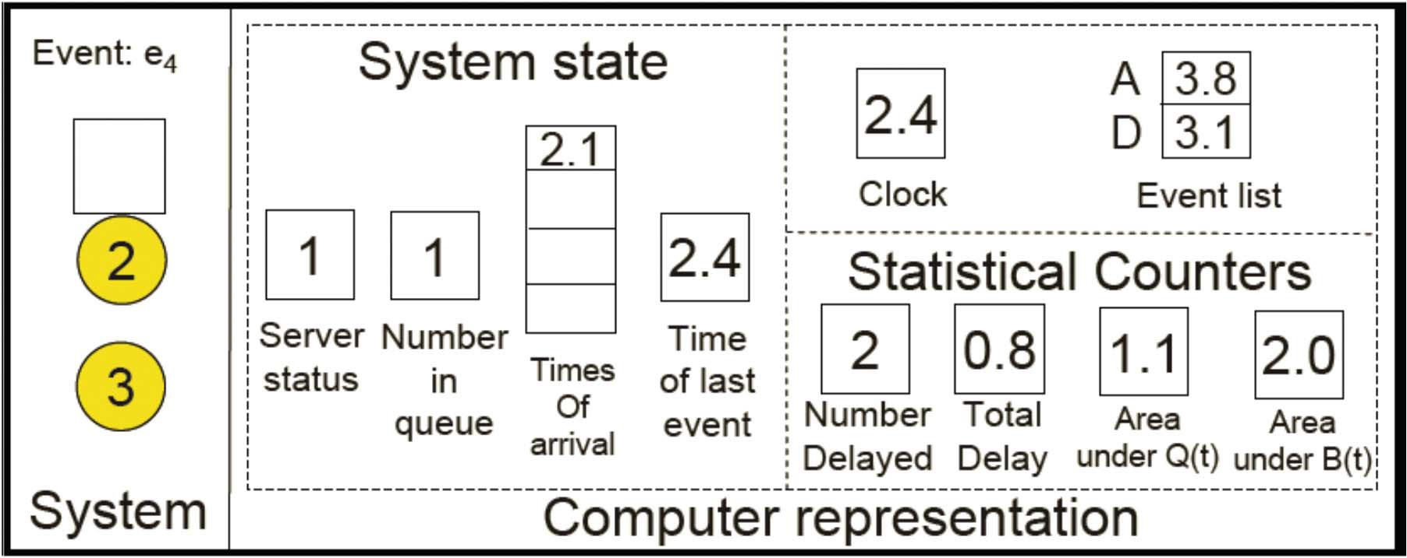
Paper-and-Pencil Simulation
Event 4: departure of Customer 1
Interarrival times: 0.4, 1.2, 0.5, 1.7, 0.2, 1.6, 0.2, 1.4, 1.9, …
Service times: 2.0, 0.7, 0.2, 1.1, 3.7, 0.6, …
D₂ = period of time that customer 2 has been in the queue = 2.4-1.6
Total delay = D₁+D₂ = 0+0.8 = 0.8

Slide 43

Paper-and-Pencil Simulation
Event 5: departure of Customer 2
Interarrival times: 0.4, 1.2, 0.5, 1.7, 0.2, 1.6, 0.2, 1.4, 1.9, …
Service times: 2.0, 0.7, 0.2, 1.1, 3.7, 0.6, …
D₃ = 3.1 - 2.1 = 1.0
Total delay = D₁+D₂+D₃ = 0+0.8+1.0 = 1.8

Slide 44
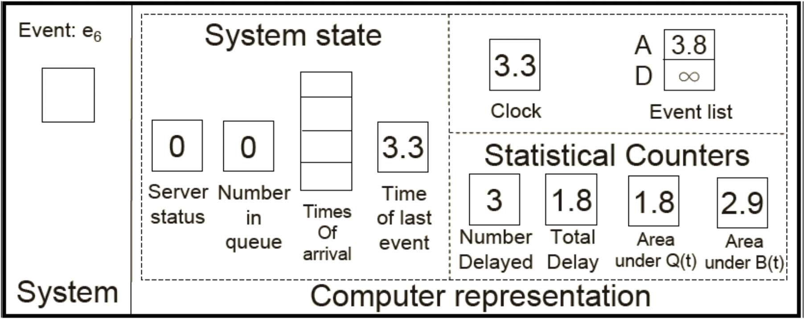
Paper-and-Pencil Simulation
Event 6: departure of Customer 3
Interarrival times: 0.4, 1.2, 0.5, 1.7, 0.2, 1.6, 0.2, 1.4, 1.9, …
Service times: 2.0, 0.7, 0.2, 1.1, 3.7, 0.6, …

Slide 45

Paper-and-Pencil Simulation
Event 7: arrival of Customer 4
Interarrival times: 0.4, 1.2, 0.5, 1.7, 0.2, 1.6, 0.2, 1.4, 1.9, …
Service times: 2.0, 0.7, 0.2, 1.1, 3.7, 0.6, …
D₄ = 0
Total delay = D₁+D₂+D₃+D₄ = 0+0.8+1.0+0 = 1.8
64

Slide 46
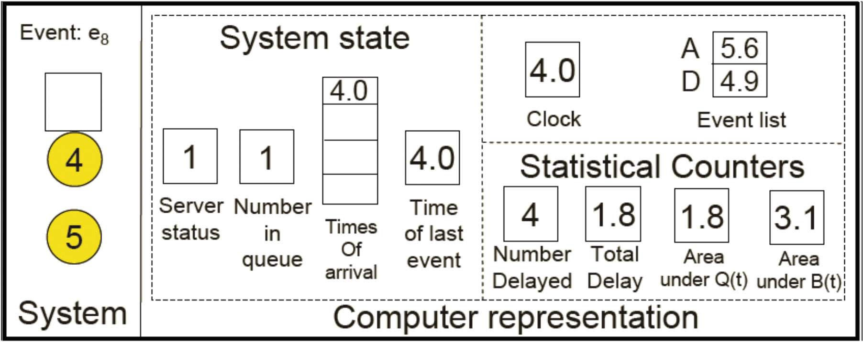
Paper-and-Pencil Simulation
Event 8: arrival of Customer 5
Interarrival times: 0.4, 1.2, 0.5, 1.7, 0.2, 1.6, 0.2, 1.4, 1.9, …
Service times: 2.0, 0.7, 0.2, 1.1, 3.7, 0.6, …

Slide 47
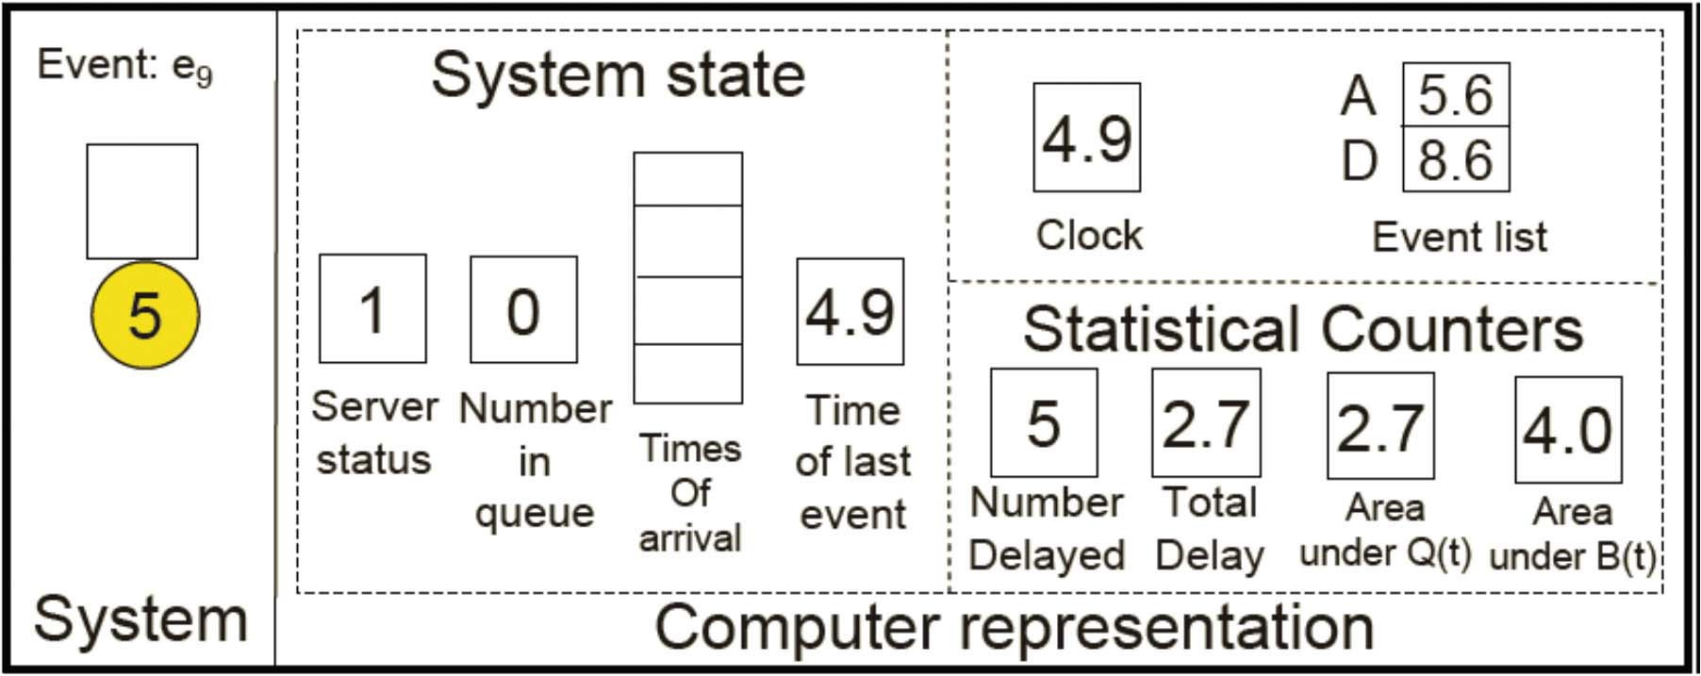
Paper-and-Pencil Simulation
Event 9: departure of Customer 4
Interarrival times: 0.4, 1.2, 0.5, 1.7, 0.2, 1.6, 0.2, 1.4, 1.9, …
Service times: 2.0, 0.7, 0.2, 1.1, 3.7, 0.6, …
D₅ = 0.9
Total delay = D₁+D₂+D₃+D₄+D₅ = 0+0.8+1.0+0+0.9 = 2.7

Slide 48

Paper-and-Pencil Simulation
Event 10: arrival of Customer 6
Interarrival times: 0.4, 1.2, 0.5, 1.7, 0.2, 1.6, 0.2, 1.4, 1.9, …
Service times: 2.0, 0.7, 0.2, 1.1, 3.7, 0.6, …

Slide 49
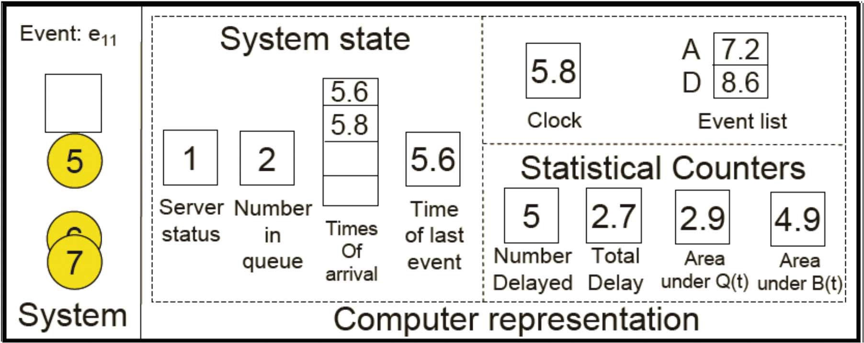
Paper-and-Pencil Simulation
Event 11: arrival of Customer 7
Interarrival times: 0.4, 1.2, 0.5, 1.7, 0.2, 1.6, 0.2, 1.4, 1.9, …
Service times: 2.0, 0.7, 0.2, 1.1, 3.7, 0.6, …

Slide 50
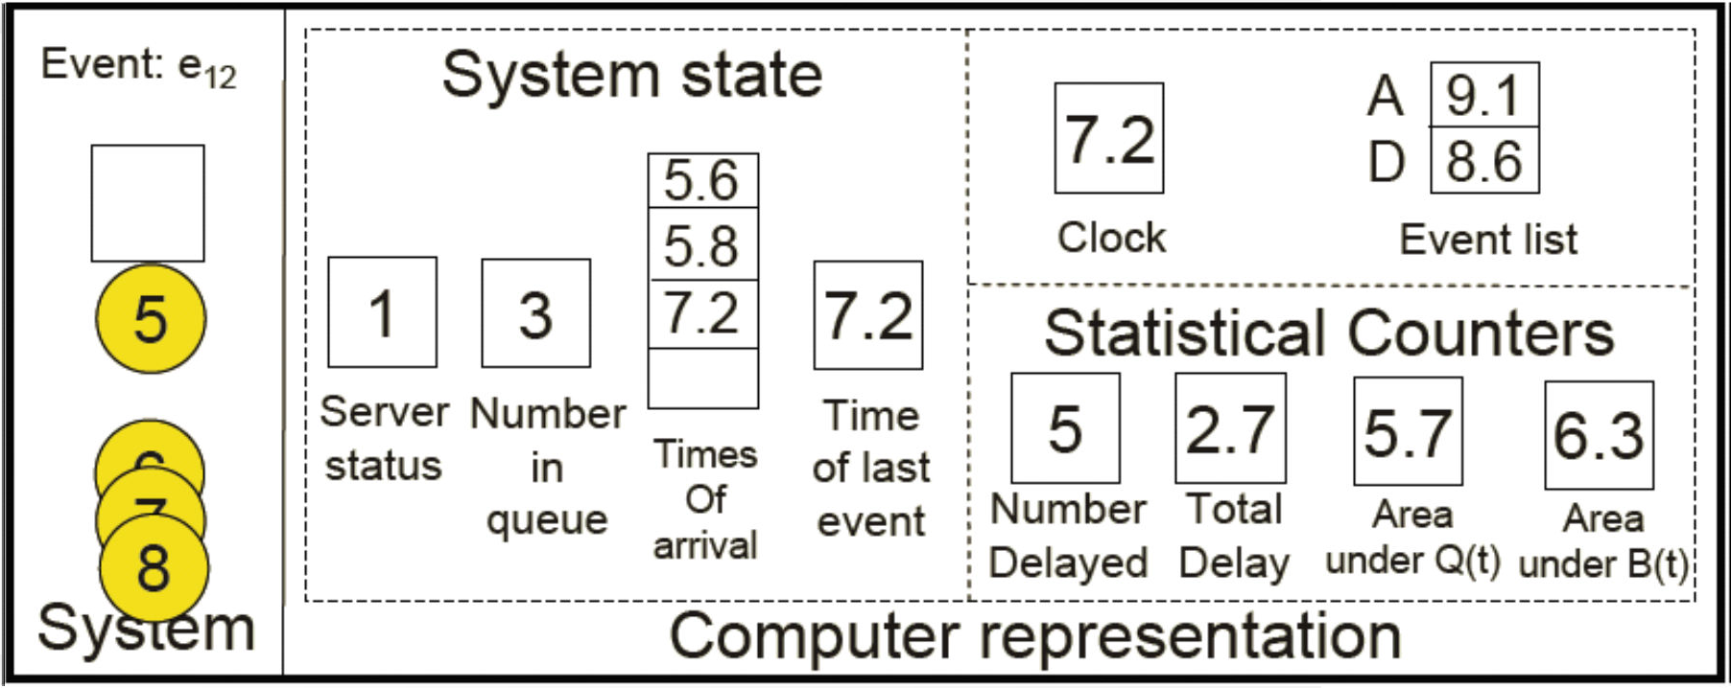
Paper-and-Pencil Simulation
Event 12: arrival of Customer 8
Interarrival times: 0.4, 1.2, 0.5, 1.7, 0.2, 1.6, 0.2, 1.4, 1.9, …
Service times: 2.0, 0.7, 0.2, 1.1, 3.7, 0.6, …

Slide 51
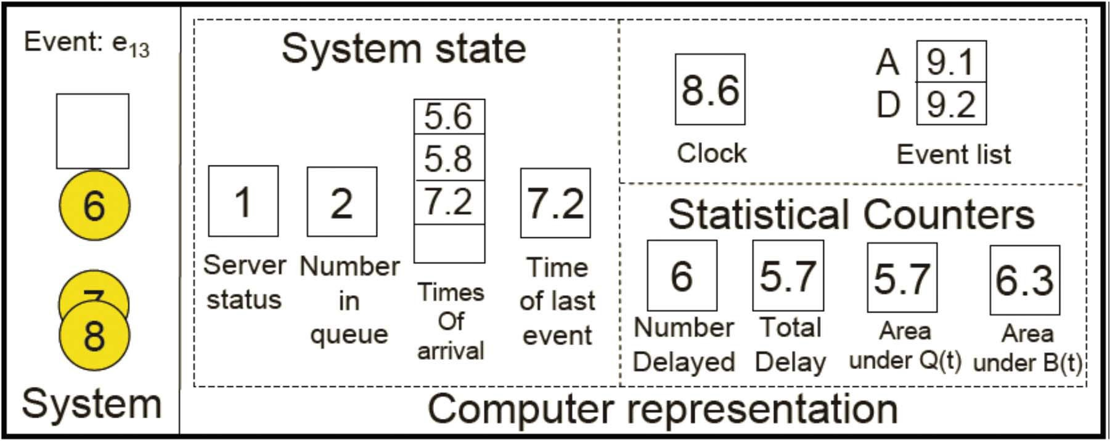
Paper-and-Pencil Simulation
Event 13: departure of Customer 5, Customer 6 end queueing, we have collected 6 piece of data! Quit!
Interarrival times: 0.4, 1.2, 0.5, 1.7, 0.2, 1.6, 0.2, 1.4, 1.9, …
Service times: 2.0, 0.7, 0.2, 1.1, 3.7, 0.6, …
D₆ = 3
Total delay = D₁+D₂+D₃+D₄+D₅+D₆ = 0+0.8+1.0+0+0.9+3 = 5.7

Slide 52
Paper-and-Pencil Simulation
Simulation Record
Event No. | time | Description | Server status | No. in queue | Times of arrival | Time of last event | No. delayed | Total delay | Area under Q(t) | Area under B(t)
1 2 3 4 5 6 7 8 9 10 11 12 13 | 0.4 1.6 2.1 2.4 3.1 3.3 3.8 4.0 4.9 5.6 5.8 7.2 8.6 | Arrival 1 Arrival 2 Arrival 3 Departure 1 Departure 2 Departure 3 Arrival 4 Arrival 5 Departure 4 Arrival 6 Arrival 7 Arrival 8 Departure 5 | 0 1 1 1 1 0 1 1 1 1 1 1 1 | 0 1 2 1 0 0 0 1 0 1 2 3 2 | --- 1.6 1.6, 2.1 2.1 --- --- --- 4.0 --- 5.6 5.6, 5.8 5.6, 5.8, 7.2 5.8, 7.2 | 0.4 1.6 2.1 2.4 3.1 3.3 3.8 4.0 4.9 5.6 5.8 7.2 8.6 | 0 1 1 2 3 3 4 4 5 5 5 5 6 | 0 0 0 0.8 1.8 1.8 1.8 1.8 2.7 2.7 2.7 2.7 5.7 | 0 0 0.5 1.1 1.8 1.8 1.8 1.8 2.7 2.7 2.9 5.7 9.9 | 0 1.2 1.7 2.0 2.7 2.9 2.9 3.1 4.0 4.7 4.9 6.3 7.7
Stopping event

Slide 53
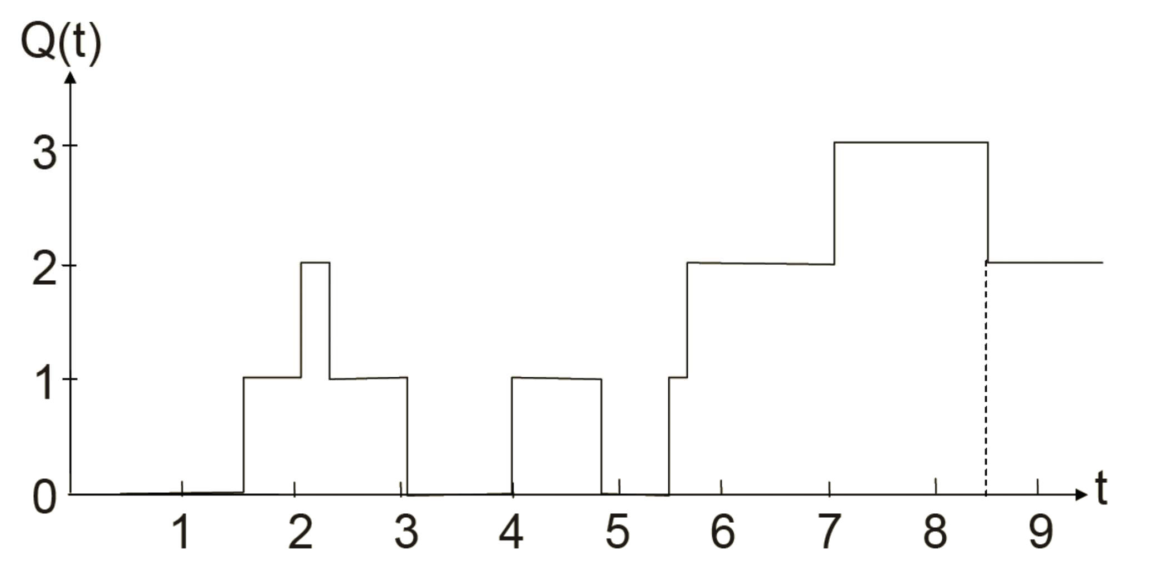
Simulation: Result
Plot of Q(t): queue length

Slide 54
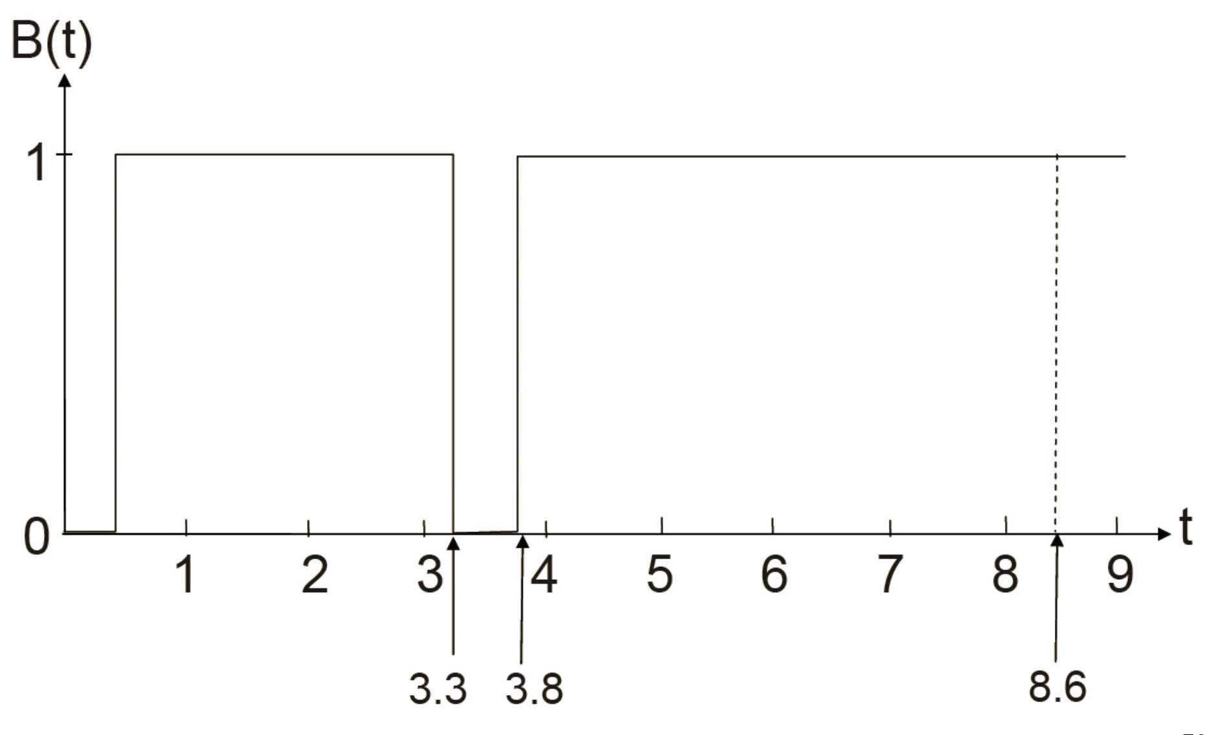
Simulation: Result
Plot of B(t): server business

Slide 55
Average Delay in Queue
A single simulation: an estimated value of average delay in queue
Average of the n Di’s:
n
∑ D_{i}
1
= D(n)
d^{ˆ}(n) =
n
If we run simulations many times, then we will obtain the
expected average delay in queue, d(n)

Slide 56
Time-Average Queue Length
Obtain the expected average queue length q(n) by running simulation many times
Let Q(t) denote the number of customers in queue at time t
Let p_{i} be the expected proportion of the time that Q(t) = i,
we have
∞
q(n) = ∑ip_{i}
i = 0
Thus q(n) is a weighted average of the queue length Q(t)

Slide 57
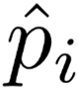
Time-Average Queue Length
Single run of simulation: estimated values for p_{i}’s
Replace the pi’s with the estimated (not expected) proportions
∞
qˆ(n) = ∑ipˆ_{i}
i =1
How to compute
T_{i:} total amount of time the queue is of length i,
■ T(n) = T₀ + T₁ + … + T_{n}
∞
∑iT_{i}
qˆ(n) =
i = 0
T (n)

Slide 58
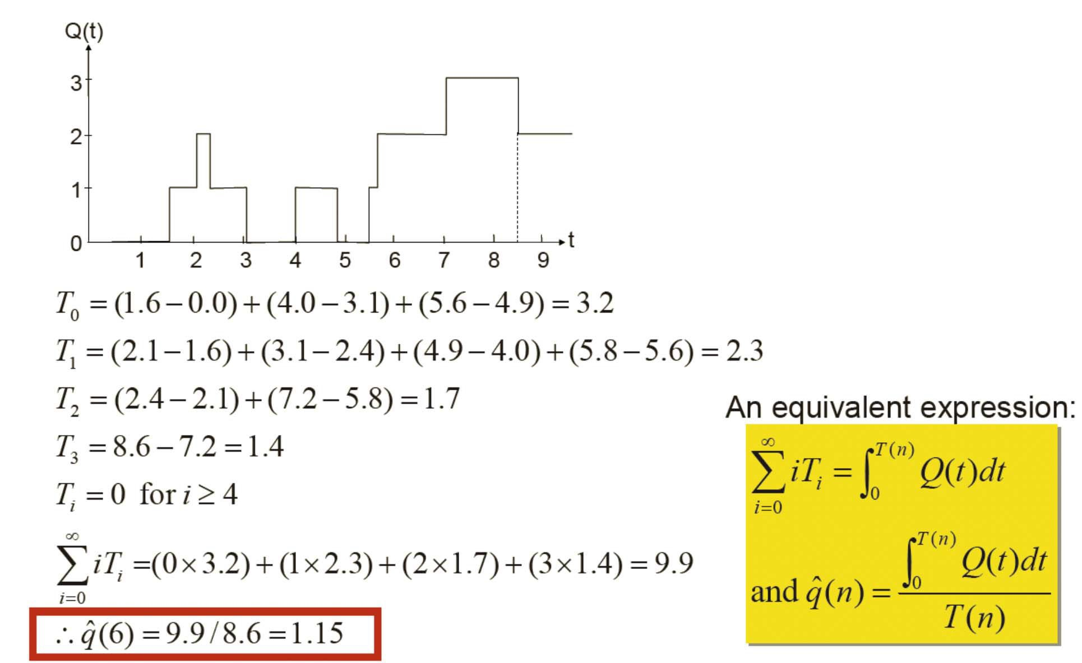
Time-Average Queue Length

Slide 59
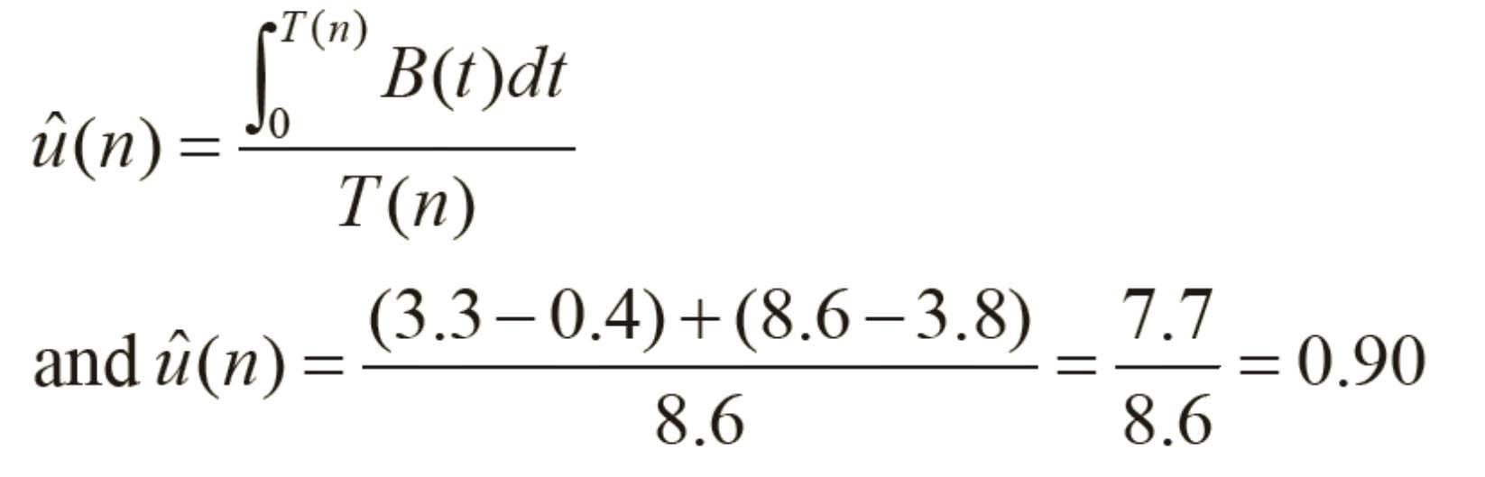
Utilization
Expected utilization: how busy the server is
the proportion of time that the server is busy
A value between 0 and 1, denoted by u(n)
Single simulation: observed utilization

Slide 60
Conclusion
Events include:
the arrival of a customer
the departure of a customer (after a service completion)
State variables to estimate d(n), q(n), and u(n) are
The status of the server (0 for idle, 1 for busy)
The number of customers in the queue
The time of the last (most recent) event
Needed to compute the width of the rectangles for the area accumulations in the estimates of q(n) and u(n)

